Slide 1
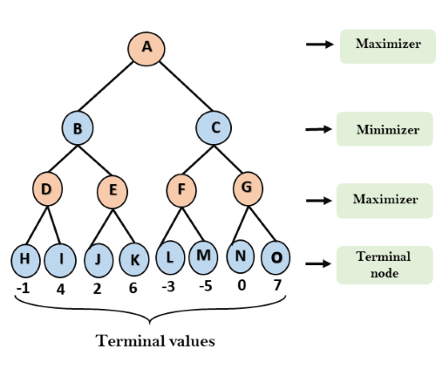
Min-max algorithm – An Example

Slide 2
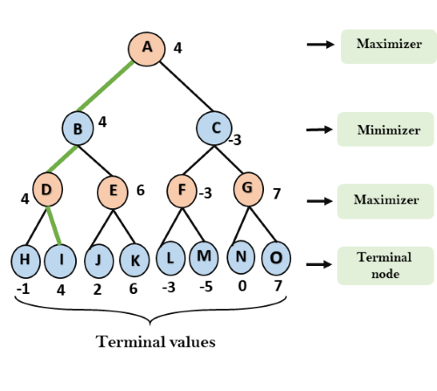
Min-max algorithm – Solution

Slide 3
Multi Player in Min-max
Multiplayer games can allow communication between players
They can form alliances
Breaking alliances might have out-of-game payoffs
In two-player non-zero-sum games, alliances can also be formed

Slide 4
Min-max algorithm - Example

Slide 5
Analysis of Min-max
Optimal play for MAX assumes that MIN also plays optimally, what if MIN does not play optimally?
A complete depth-first search?
Yes
Time complexity?
O( )
Space complexity?
O(bm) (depth-first exploration)
For chess, b ≈ 35, m ≈ 100 for "reasonable“ games
exact solution completely infeasible

Slide 6
Optimal Decisions in Games
• Evaluating the whole game tree is cumbersome
Solution: Pruning
No need to evaluate values that cannot change minimum / maximum

Slide 7
α-β Pruning

Slide 8
α-β Pruning
The number of game states with minimax search is exponential in the # of moves
Is it possible to compute the correct minimax decision without looking at every node in the game tree?
Need to prune away branches that cannot possibly influence the final decision

Slide 9
Basic Idea of α-β
If Player has a better choice
m either at the parent of n or
at any choice point further up,
then n will never be reached in
actual play
α-β pruning gets it name from
the two parameters that
describe bounds on the
backed-up values

Slide 10
Definitions of α and β
α = the value of the best (highest-value) choice we have found so far at any choice point along the path for MAX.
β = the value of the best (lowest-value) choice we have found so far at any choice point along the path for MIN.
α-β search updates the values of α and β as it goes along and prunes the remaining branches at a node as soon as the value of the current node is worse than the current α or β for MAX or MIN respectively.

Slide 11
Now, Trace The Behaviour

Slide 12
Initially…

Slide 13
After Pruning..

Slide 14
Finally…

Slide 15
All steps at a glance..

Slide 16
A Simple Formula

Slide 18
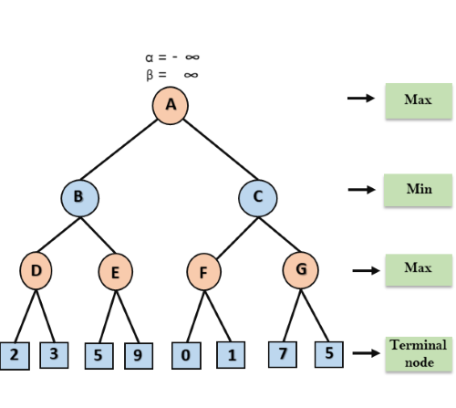
Example-2

Slide 19
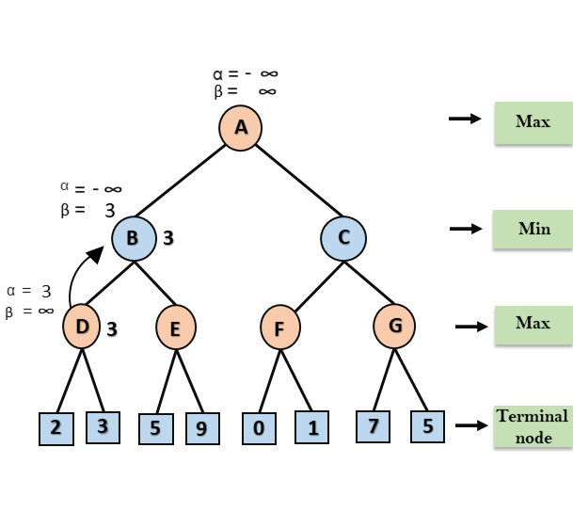

Slide 20
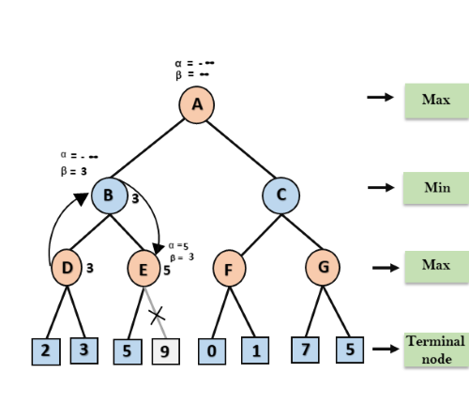

Slide 21
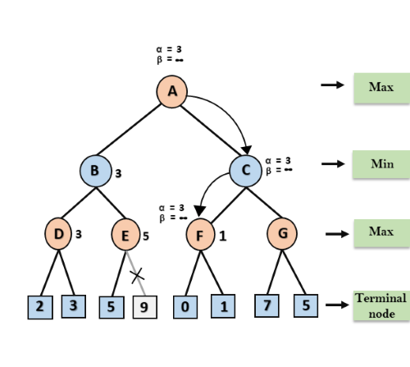

Slide 22
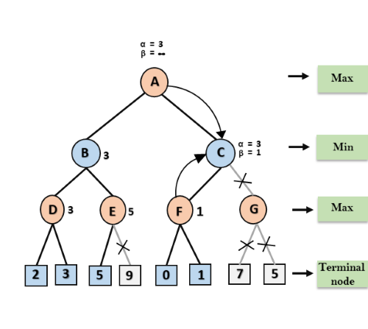

Slide 23
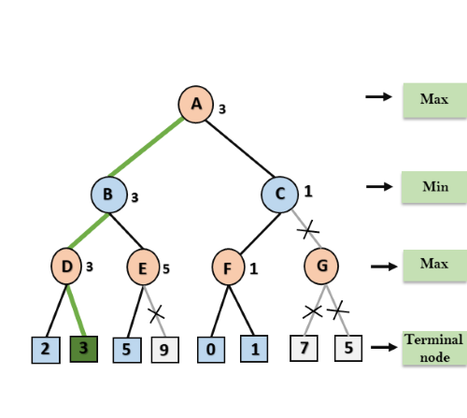

Slide 24
Analysis of α-β

Slide 25
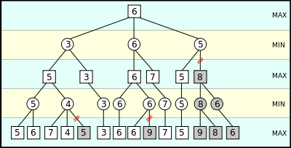
Example-3

